Slide 1

Internship Final Report
QA & Accessibility Optimization Post-Migration – coe.unt.edu
Pralay Bhattacharjee
August 2025

Slide 2
What Have I Done?
Post-Migration Audit: Conducted QA and Accessibility checks after migration.
Issue Identification: Found broken components, missing alt text, improper links and dependencies.
Fix Implementation: Used Siteimprove and Smartsheet to fix and report issues.
Tool Usage: Modern Campus CMS, Smartsheet, Siteimprove, MS Teams and Outlook.

Slide 3
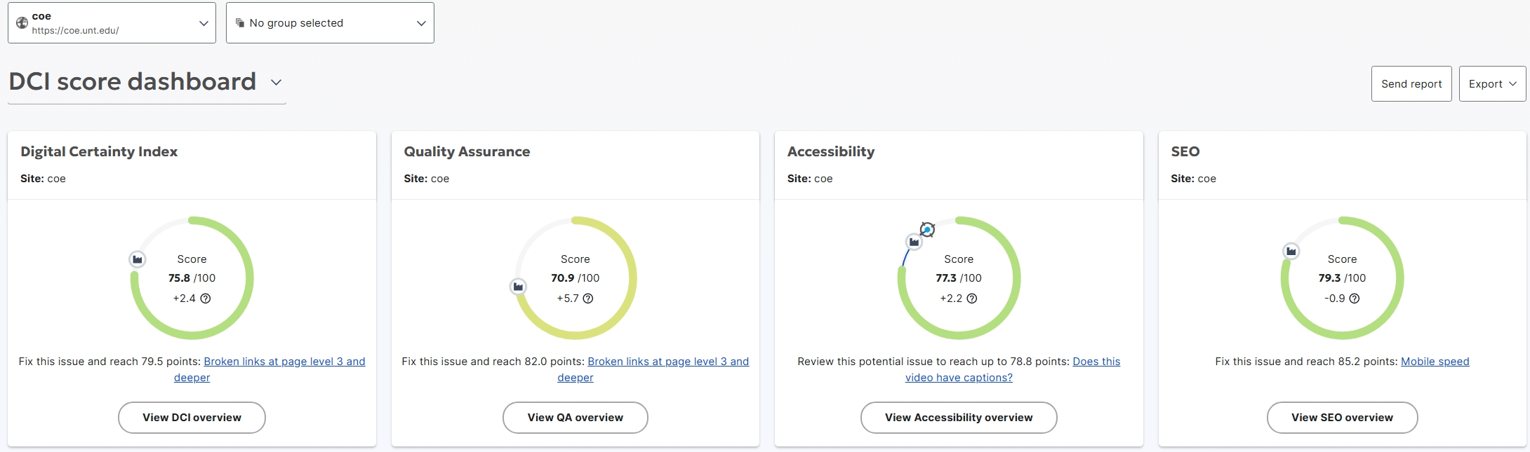
Past Status As of June 2025
QA Score: 70.9 (up from ~50)
Accessibility Score: 77.3 (up from ~65)
~15-point improvement across both areas since migration.
Reflects effective QA pipeline and issue resolution.

Slide 4
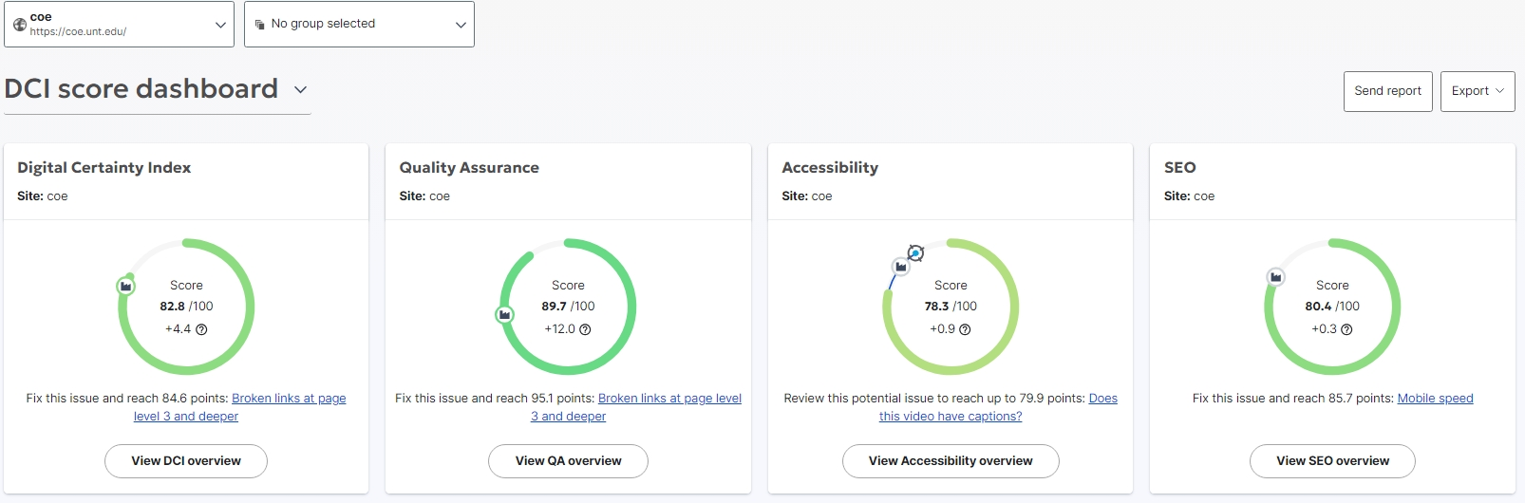
Current Status
QA Score: 89.7 (up from ~50)
Accessibility Score: 78.3 (up from ~65)
~40-point improvement in QA and 14 points in Accessibility since migration.
Reflects effective QA pipeline and issue resolution.

Slide 5
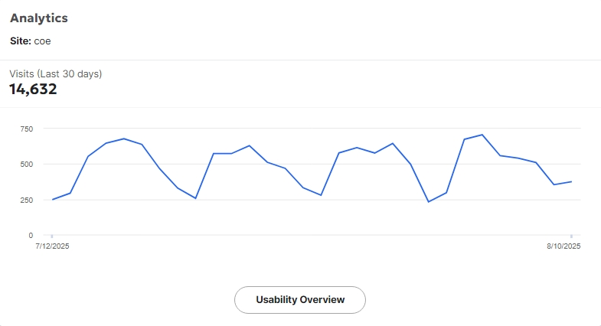
COE Site Visit Analytics
Number of visits increased by 14,362

Slide 6
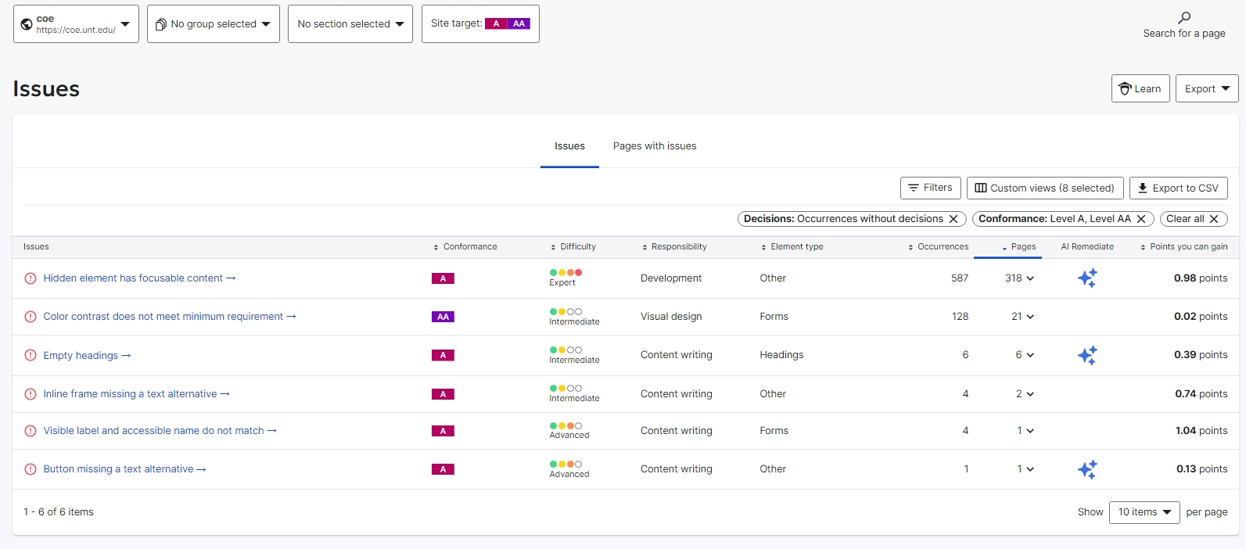
Issues: Accessibility
Points that can be gained: 3.3

Slide 7
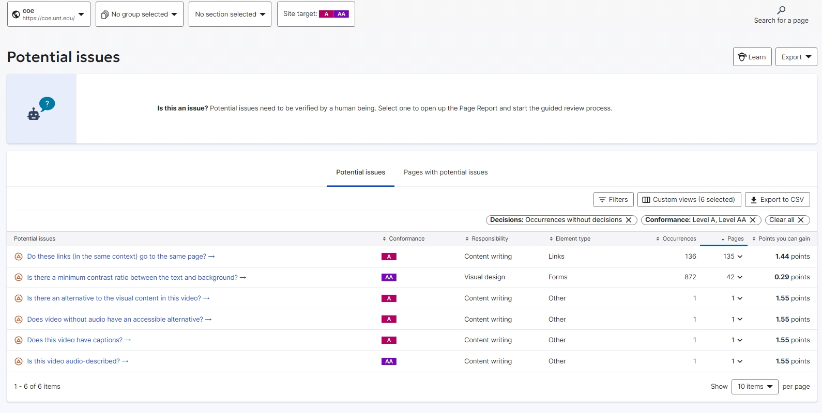
Potential Issues: Accessibility
Potential Points that can be gained: 8.99

Slide 8
Team Resources Required
QA Resource: Continuous stakeholder feedback, automation support for recurring issues across pages, and a well-defined layout structure for comprehensive site coverage.
Accessibility SME: Expert to guide WCAG 2.1 compliance.
Design Support: UI/UX assistance for contrast and focus states.

Slide 9
Summary
By fixing up to 2600 coe pages QA and Accessibility score has increased by 46%.
There's been a good response from the webpages and total COE page visit increased closed to 15,000 in last one month.
Accessibility score can be increased by up to 12% if the issues and potential issues are addressed by dev team.

